Slide 1
Lab 13 Record Locking
TA:Guo-Wei Chen
Professor: Hsung-Pin Chang
Operating System Lab

Slide 2
Record Locking
What happens when two process attempt to edit the same file at the same time ?
Record locking is the ability of a process to prevent other processes from modifying or reading a region of a file while the first process is working on it.

Slide 3
Advisory vs. Mandatory Locking
Advisory (default in Linux distribution)
All access functions handle record locking in a consistent way.
But advisory locking doesn’t prevent other process that has write permission for file from writing.
file
fget()
read()
A rude process with write permission of the file
fput()

Slide 4
Advisory vs. Mandatory Locking
Mandatory (default in Windows)
Kernel checks every read(), write(), open() operation to prevent the calling process from violating the lock rule.
Linux kernel
fget()
write()
file
check
read()
fput()

Slide 5
Read lock vs. Write lock
Read lock (Shared lock) | Any number of processes can have a shared read lock on a given region of a file. All of them can read from the file but can’t write to it.
Write lock (Exclusive lock) | Only one process can have an exclusive lock on a given region of a file. The other process are prevented from getting locks or reading and writing.
Lock Request Current lock type | Read lock (Share lock) | Write lock (Exclusive lock)
no lock | Yes | Yes
Read lock (Share lock) | Yes | No
Write lock (Exclusive lock) | No | No
NCHU System & Network Lab

Slide 6
Record Locking Functions
Record locking functions：
fcntl()
Support write lock、read lock and record lock.
If successful, return 0
If fail, return -1
lockf()
Only support write lock and a part of record lock.
Now we focus only on fcntl() function.

Slide 7
fcntl() Function (1/5)
fcntl() function can change the properties of a file that is already open.
The fcntl() is used for five different purposes :
#include <fcntl.h> int fcntl (int filedes, int Cmd, /*struct flock *flockptr*/…);
Cmd | Description
F_DUPFD | Duplicate an existing descriptor
F_GETFD,F_SETFD | Get/set file descriptor flags
F_GETFL,F_SETFL | Get/set file status flags (O_RDWR … etc)
F_GETOWN,F_SETOWN | Get/set asynchronous I/O ownership
F_GETLK,F_SETLK, F_SETLKW | Get/set/lock file lock, it discussed later.

Slide 8
fcntl() Function (2/5)
For record locking ,the third argument of fcntl() is a pointer to a flock structure :
struct flock { short l_type; /* F_RDLCK, F_WRLCK, F_UNLCK */ short l_whence; /* SEEK_SET, SEEK_CUR, SEEK_END */ off_t l_start; /* offset in bytes, start of the blocking lock*/ off_t l_len; /* length, in bytes ; 0 means lock to EOF */ pid_t l_pid; /* returned with F_GETLK */ }

Slide 9
fcntl() Function (3/5)
Three commands of fcntl() :
F_GETLK
To check the lock described by flockptr :
The information pointed by flockptr is overwritten by an existing lock .
If no lock exists, flockptr.l_type = F_UNLCK
F_SETLK
Set the lock described by flockptr.
If we try to obtain an illegal record lock, fcntl() will return error ,EAGAIN.
F_SETLKW
A blocking version of F_SETLK, waiting until the file can be locked.

Slide 10
fcntl() Function (4/5)
Example code:
#include <stdio.h> #include <unistd.h> #include <fcntl.h> #include <string.h>
struct flock* file_lock(short type, short whence) { static struct flock ret; ret.l_type = type ; // lock type ret.l_start = 0; ret.l_whence = whence; ret.l_len = 0; // EOF }

Slide 11
fcntl() Function (5/5)
Example code (cont.):
int main() {
int fd = open("1.txt", O_WRONLY|O_APPEND);
fcntl(fd, F_SETLK, file_lock(F_WRLCK, SEEK_SET));
// It will return 0 if the file is locked successfully!
……
fcntl(fd, F_SETLKW, file_lock(F_UNLCK, SEEK_SET));
……
}

Slide 12
Example 1: Advisory Locking

Slide 13
Advisory Locking (1/7)
We used two programs to lock the same file.
Program1: file_lock.c
Program2: try_to_lock.c
Locked file: lock.txt
Program1 have RL and WL option.
Program2 try to lock the same file which the program1 was already
locked(lock.txt).

Slide 14
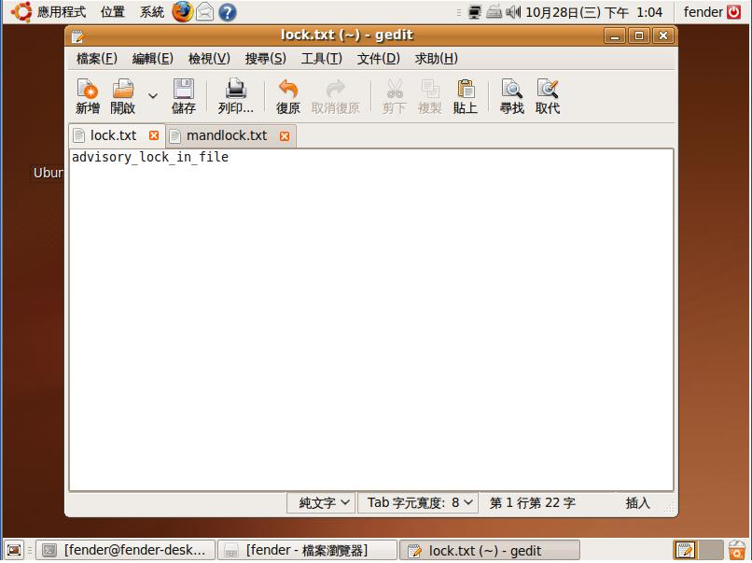
Advisory Locking(2/7)
lock.txt

Slide 15
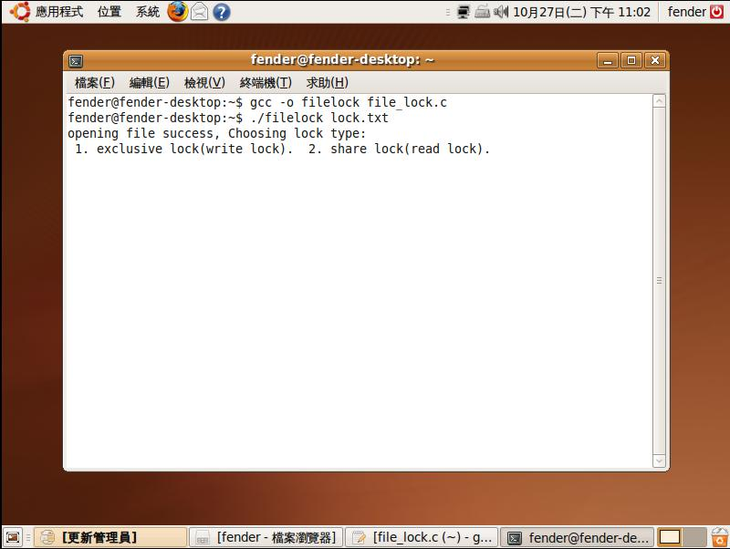
Advisory Locking(3/7)
Program1 (file_lock.c)
Two option, WL and RL.

Slide 16
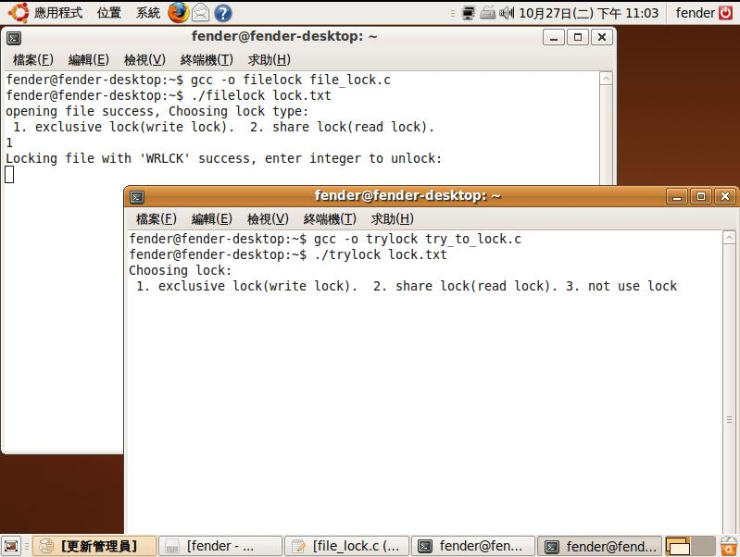
Advisory Locking(4/7)
Program2 (try_to_lock.c)
choosing WL
Program2 try to lock the same file.
(file: lock.txt)

Slide 17
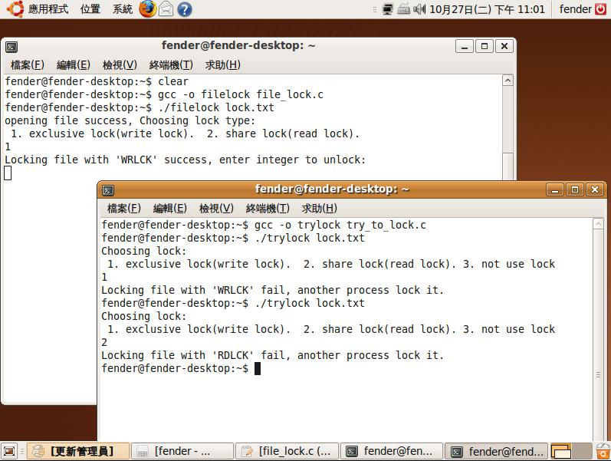
Advisory Locking(5/7)
WL now
If file was locked by WL already, another program can’t lock (WL or RL) the same file.

Slide 18
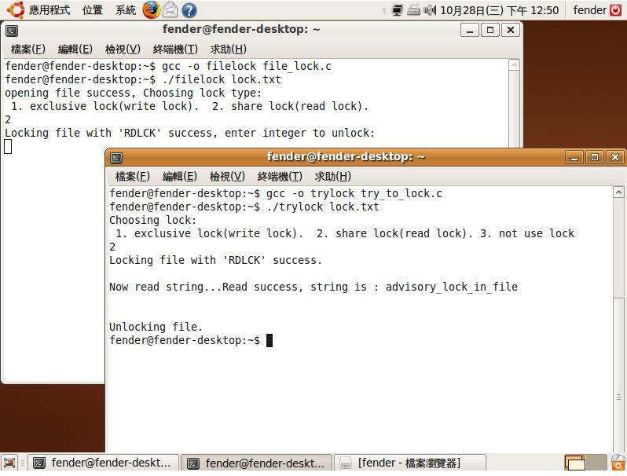
Advisory Locking(6/7)
RL now
If file was locked by RL already, another program only can use RL to locked the same file. (WL can’t)

Slide 19
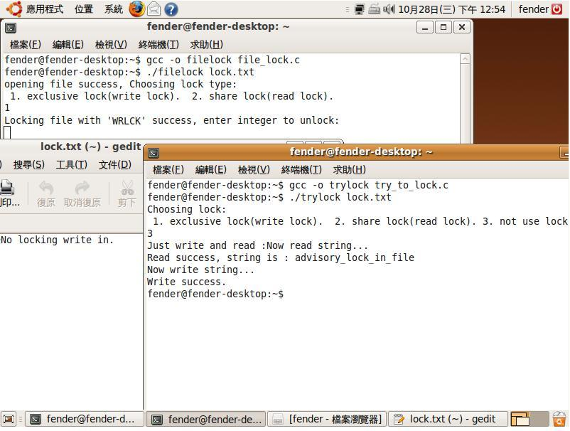
Example: Advisory Locking(7/7)
Not use lock, reading and writing the file directly.
WL now
File Content has been modified.
(contrast with page 13)
Why?

Slide 20
Excises I
Using advisory locking.
Running two processes, one process use write lock to lock a file, another process waits until the same file can be locked (using WL or RL). [+25pt]
Following above exercise, two processes use RL to lock the same file.
Must show the file contents. (display on the screen.) [+25pt]
In page 18, why program2 can read and write a already locked file ? [+10pt]

Slide 21
Example 2: Mandatory Locking

Slide 22
Mandatory Locking (1/8)
Mandatory: (newly supported by Linux kernel)
Step 1 :
Mounting the file system with the mand option:
# mount /dev/device /location
(ex: mount /dev/sda3 /mnt)
# mount –o remount,mand /dev/mount device /location
(ex: mount –o remount,mand /dev/sda3 /mnt)
You could use mount | grep mnt to check mount state.

Slide 23
Mandatory Locking(2/8)
Step 2:
Setting permissions which file you want to locked:
# chmod g+s zzz.txt (ex: chmod g+s lock.txt)
# chmod g-x zzz.txt (ex: chmod g-x lock.txt)
Setting group id bit and clear group execute bit.
These steps let your kernel know you want to use mandatory locking.

Slide 24
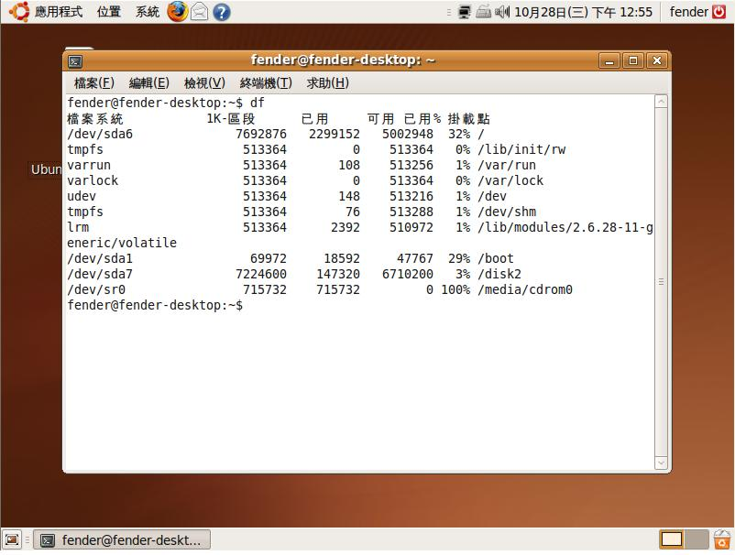
Mandatory Locking(3/8)

Slide 25
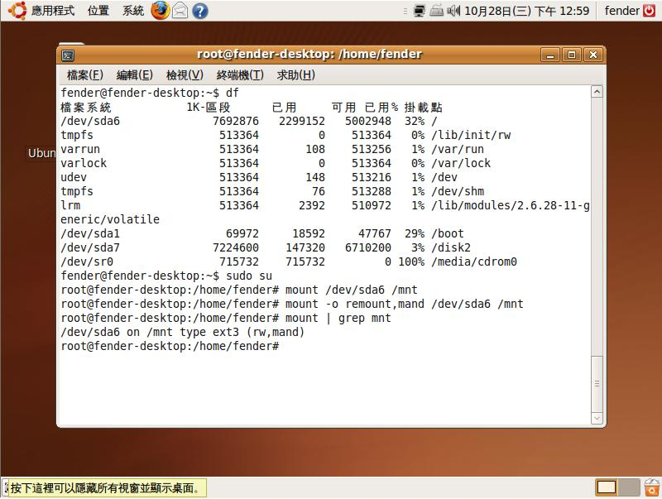
Mandatory Locking (4/8)
Making your file system support mandatory locking

Slide 26
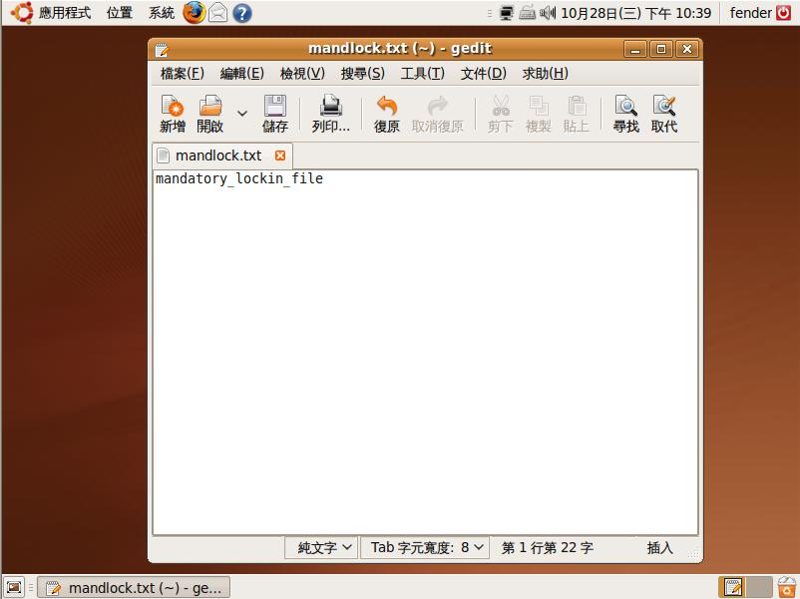
Mandatory Locking(5/8)
mandlock.txt

Slide 27
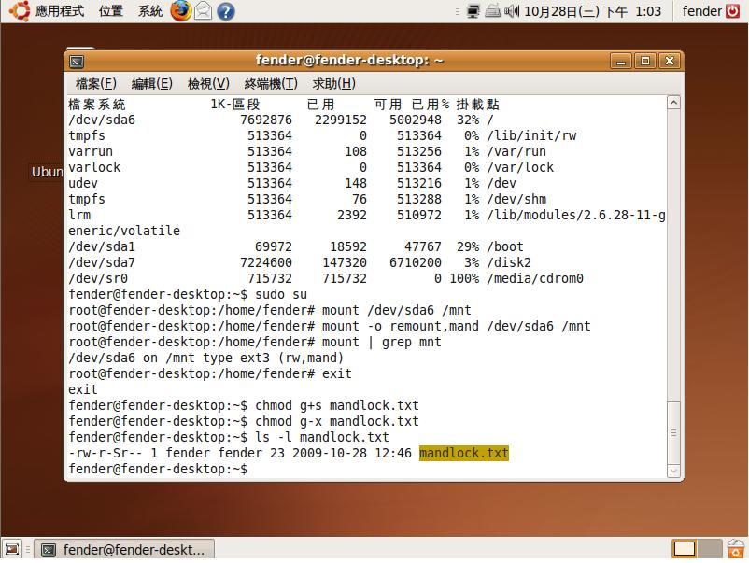
Mandatory Locking (6/8)
Change file permissions.

Slide 28
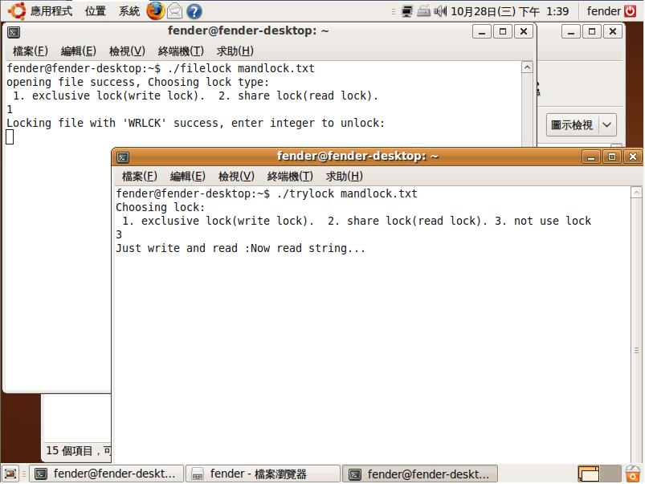
Mandatory Locking (7/8)
WL now
Can’t read and write file.

Slide 29
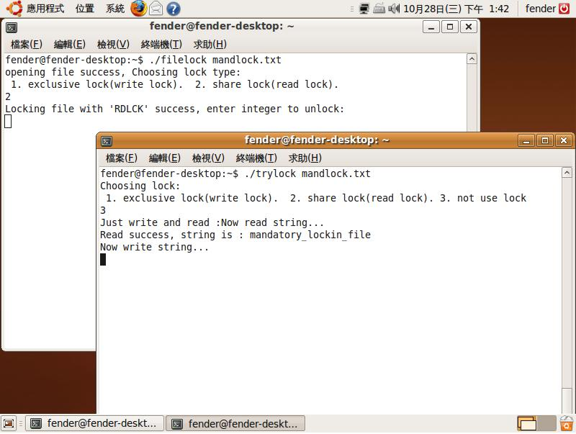
Mandatory Locking (8/8)
RL now
Can read file but can’t write.

Slide 30
Excises II
Using mandatory locking.
One process lock (WL or RL) a file, another process write or read the same file directly(not use lock).
Write lock test. [+15pt]
Read lock test. [+15pt]

Slide 31
Reference
Mandatory vs Advisory
http://boson4.phys.tku.edu.tw/UNIX/Unix%20Dictionary/UNIX%20M.htm#Mandatory locking
Fcntl() function:
http://www.ibm.com/developerworks/cn/linux/l-cn-filelock/index.html
http://hi.baidu.com/mgqw/blog/item/1f1e57398fd2bbfb3b87cecc.html
Mandatory in linux:
http://www.hackinglinuxexposed.com/articles/20030623.html
Others:
http://www.unixresources.net/linux/clf/program/archive/00/00/43/60/436084.html#article436190
http://hi.baidu.com/zmingliu/blog/item/40636f3d7b710f06bba1673d.html

